Slide 1

Demographic Location Surface Water Mapping
Abhishek Rajput (22070122007)
Arnav Jain (22070122030)
Atul Goyal (22070122039)
Janmejay Pandya (22070122086)
Under the Guidance of
Dr. Nilima Zade

Slide 2
Content
Introduction | 01
Problem Statement | 02
Objectives of Study | 03
Existing System | 04
Methodology and Dataset Description | 05
Models Selection | 08
Resources | 09
Algorithm | 10
Work Breakdown Structure | 13
Results and Comparison | 14
References | 25

Slide 3
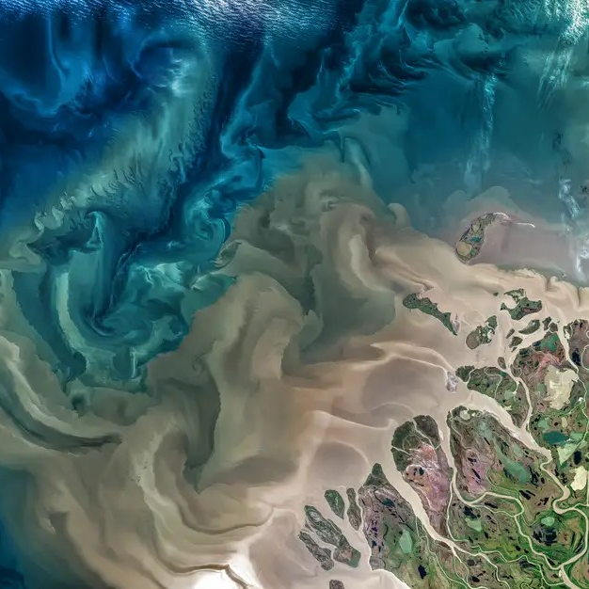
Introduction
In today’s world, where urban development and the impact of climate change present obstacles to our water resources, the Demographic Location Surface Water Mapping Project emerges as an much needed initiative.

Slide 4
Problem Statement
To develop an effective satellite image classification system Utilizing the Image Processing technique and ML based algorithms while addressing challenges posed by sun and mountain shadows. With shadow correction methods, we aim to accurately classify land and water areas in satellite imagery for a specific time period, considering the impact of shadows on image interpretation.

Slide 5
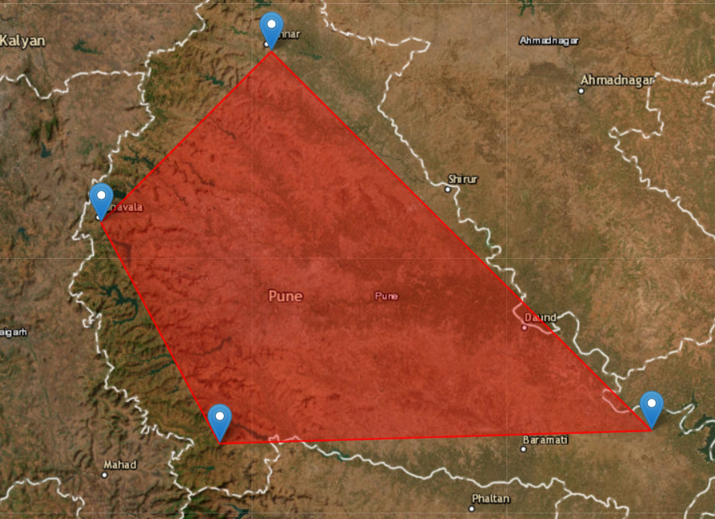
Objective of Study
This project aims to map the surface water bodies by employing satellite imagery and digital image processing techniques. The objectives include:
1. Analysing the existing datasets and Image Processing techniques applied.
2. Design and development of ML based Algorithms.
3. Result analysis and comparison.

Slide 6
Existing System
Key methodologies
CNNs, SVMs, deep learning, and reinforcement learning, etc.
Datasets
High-resolution satellite images, Landsat multi-spectral imagery, UAV remote sensing data, etc.
14 Research papers (2010 to 2023)
Outcomes demonstrate considerable success in improving classification accuracy, mapping precision, and environmental assessment capabilities, etc.
Challenges
Data quality, model validation, computational efficiency, and the adaptability of these systems to new or varying conditions, etc.

Slide 7
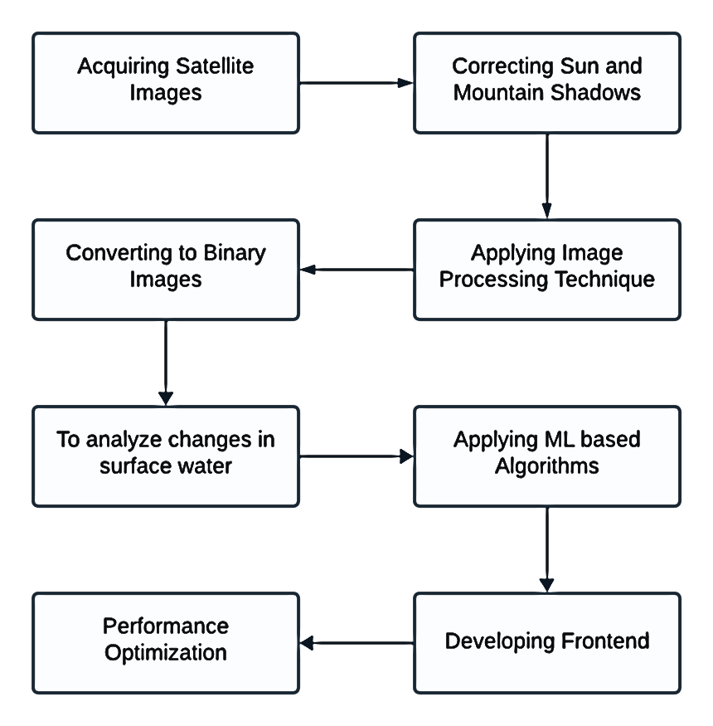
Methodology

Slide 8
Dataset Description
The dataset used in this study comprises Landsat 8 Operational Land Imager (OLI) images, specifically captured over the Pune District.
Source: All images in the dataset were sourced from the US Geological Survey (USGS) Global Visualization Viewer, a public repository of satellite imagery. https://earthexplorer.usgs.gov/
Spatial Coverage: Path: 147 Row: 047 Region: Pune District

Slide 9
Dataset Description
Temporal Coverage: Start Date: January 2014 End Date: December 2023
Acquisition: The dataset was manually curated on 02/03/2024, ensuring that the selected images are of the highest quality and relevance to the study's objectives.
Data Characteristics: Resolution: The Landsat 8 OLI images offer a resolution of 30 meters. Bands: The OLI sensor on Landsat 8 captures data in multiple bands, including visible, near-infrared, and shortwave infrared regions.

Slide 10
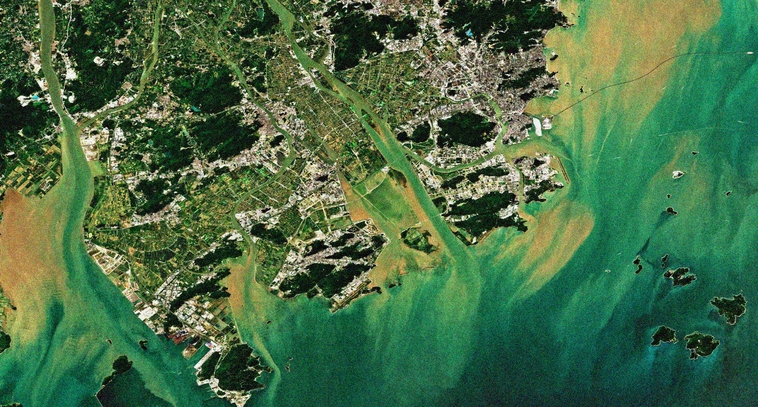
Model Selection
SNO | Models
1 | Linear Regression
2 | Polynomial Regression (Degree 1,2,3,4)
3 | Random Forest
4 | Gradient Boosting
5 | Support Vector Machine
6 | K-Nearest Neighbours
7 | XGBoost
8 | Neural Networks

Slide 11
Resources
1 | Hardware | Processor: Intel i7, 4.6 GHz
 |  | Storage: 1 TB SSD
 |  | Ram: 32 GB
2 | Software | Python
 |  | Python Libraries: OS, Math, Numpy, Pandas, Matplotlib, Rasterio, Scipy, Sklearn, XGBoost, Tensorflow
 |  | HTML, CSS, JS

Slide 12
Algorithm
Step 1: Data Extraction
Load Data: Load metadata files (.MTL) from specified file paths.
Parse Metadata: Parse each metadata file to extract relevant information such as the sun elevation angle.
Extract Date: Extract date information from the folder name in each file path.
Step 2: Data Processing
Load Raster Data: Load raster data for bands 3 and 7 from each folder path.
Sun Correction: Apply sun correction to the raster data based on the sun elevation angle from the metadata.
Calculate MNDWI: Calculate the Modified Normalized Difference Water Index (MNDWI) using bands 3 and 7.
Filter MNDWI: Apply a median filter to smooth the MNDWI data.
Create Binary Image: Convert the filtered MNDWI to a binary image where water is marked as 1 and land as 0.
Calculate Areas: Calculate the water and land areas based on the binary image and pixel area.

Slide 13
Algorithm
Step 3: Display Results
Display Image: Display the binary image with appropriate titles and colorbar.
Print Results: Print the water and land areas in square meters and hectares, along with the percentages.
Step 4: Record Data
Store Data: Store the date, water area, and land area in a list or dictionary for later use.
Step 5: Prepare Dataset for Modeling
Create DataFrame: Convert the stored data into a pandas DataFrame.
Create Ordinal Dates: Convert dates to ordinal values for easier modeling.
Step 6: Model Training and Forecasting
Split Data: Split the dataset into training and testing sets using a test size of 20%.
Select Model: Depending on user choice, select a modeling algorithm such as linear regression, polynomial
regression, random forest, etc.
Create Model Pipeline: If using polynomial regression, create a pipeline combining polynomial features and the
model.

Slide 14
Algorithm
Train Model: Train the selected model using the training set.
Make Predictions: Use the trained model to make predictions on the testing set.
Calculate Metrics: Calculate evaluation metrics such as mean squared error (MSE), root mean squared error (RMSE),
and R² score.
Print Metrics: Print the calculated evaluation metrics.
Step 7: Future Forecasting
Prepare Future Dates: Generate future dates for forecasting.
Predict Future: Use the trained model to make predictions for future dates.
Format Predictions: Format future predictions to make them easily interpretable.
Print Forecast: Print the forecasted future values.
Step 8: Menu Selection
Show Menu: Display the menu with different modeling options and choices.
User Selection: Accept user input for selecting the modeling approach.
Execute Choice: Execute the modeling and forecasting based on user choice.

Slide 15
Work Breakdown Structure
SNO | Task | Time Period
1 | Project Management | Week 1-2
2 | Data Acquisition | Week 3-4
3 | Image Preprocessing | Week 5-6
4 | Image Processing | Week 7
5 | Machine Learning Classification | Week 8-11
6 | Data Analysis | Week 12
7 | Frontend Development for Display | Week 13

Slide 16
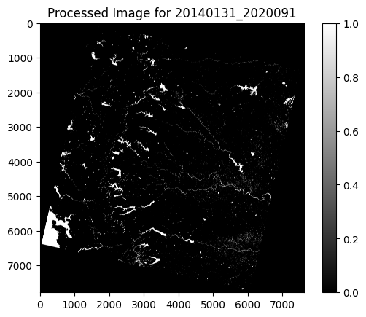
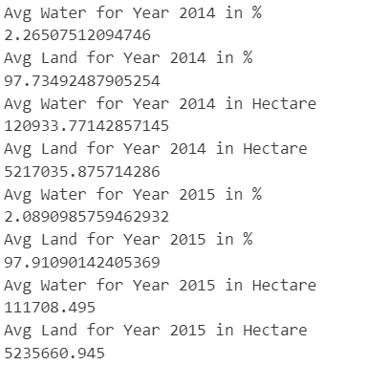
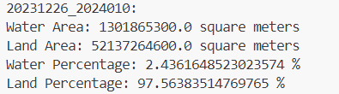
Results

Slide 17
Results
Year | AVG. WATER AREA (Hectare) | AVG. LAND AREA (Hectare)
2014 | 120933.771 | 5217035.875
2015 | 111708.495 | 5235660.945
2016 | 121861.394 | 5225508.045
2017 | 111559.176 | 5232353.814
2018 | 105573.124 | 5238339.865
2019 | 106398.385 | 5239497.432
2020 | 125333.336 | 5220296.628
2021 | 156766.02 | 5194107.87
2022 | 122049.374 | 5225344.064
2023 | 122935.635 | 5224457.805

Slide 18
Average Water And Land Readings

Slide 19
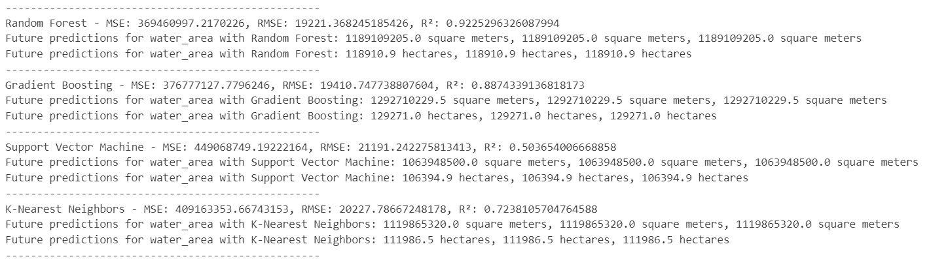
Results

Slide 20
Results
SNO | Algorithm Used | Month | Future Prediction Water (Hectare) | Future Prediction Land (Hectare)
1 | Linear Regression | Month 1 | 131010.6 | 5215581.0
 |  | Month 2 | 131405.1 | 5215161.9
 |  | Month 3 | 131831.2 | 5214708.4
2.1 | Polynomial Regression (Degree 1) | Month 1 | 131010.6 | 5215581.0
 |  | Month 2 | 131405.1 | 5215161.9
 |  | Month 3 | 131831.2 | 5214708.4
2.2 | Polynomial Regression (Degree 2) | Month 1 | 130985.7 | 5215598.6
 |  | Month 2 | 131379.7 | 5215179.6
 |  | Month 3 | 131805.2 | 5214726.2

Slide 21
Results
SNO | Algorithm Used | Month | Future Prediction Water (Hectare) | Future Prediction Land (Hectare)
2.3 | Polynomial Regression (Degree 3) | Month 1 | 130960.7 | 5215616.3
 |  | Month 2 | 131354.1 | 5215197.4
 |  | Month 3 | 131779.1 | 5214744.0
2.4 | Polynomial Regression (Degree 4) | Month 1 | 130935.5 | 5215634.2
 |  | Month 2 | 131328.4 | 5215215.4
 |  | Month 3 | 131752.8 | 5214762.0
3 | Random Forest | Month 1 | 118910.9 | 5225912.4
 |  | Month 2 | 118910.9 | 5225912.4
 |  | Month 3 | 118910.9 | 5225912.4

Slide 22
Results
SNO | Algorithm Used | Month | Future Prediction Water (Hectare) | Future Prediction Land (Hectare)
4 | Gradient Boosting | Month 1 | 129271.0 | 5214039.8
 |  | Month 2 | 129271.0 | 5214039.8
 |  | Month 3 | 129271.0 | 5214039.8
5 | Support Vector Machine | Month 1 | 106394.9 | 5237442.4
 |  | Month 2 | 106394.9 | 5237442.4
 |  | Month 3 | 106394.9 | 5237442.4
6 | K-Nearest Neighbours | Month 1 | 111986.5 | 5233327.0
 |  | Month 2 | 111986.5 | 5233327.0
 |  | Month 3 | 111986.5 | 5233327.0

Slide 23
Results
SNO | Algorithm Used | Month | Future Prediction Water (Hectare) | Future Prediction Land (Hectare)
7 | XGBoost | Month 1 | 130182.7 | 5213735.7
 |  | Month 2 | 130182.7 | 5213735.7
 |  | Month 3 | 130182.7 | 5213735.7
8 | Neural Network | Month 1 | 173.4 | 297.3
 |  | Month 2 | 173.4 | 297.3
 |  | Month 3 | 173.4 | 297.4

Slide 24
Results
SNO | Algorithm Used | RMSE (Water) | RMSE (Land) | R² (Water) | R² (Land)
1 | Linear Regression | 20101.4880 | 19853.4783 | 0.7504 | 0.7652
2.1 | Polynomial Regression (Degree 1) | 20101.4885 | 19853.4785 | 0.7504 | 0.7652
2.2 | Polynomial Regression (Degree 2) | 20102.0943 | 19853.8129 | 0.7503 | 0.7652
2.3 | Polynomial Regression (Degree 3) | 20102.7065 | 19854.1520 | 0.7501 | 0.7651
2.4 | Polynomial Regression (Degree 4) | 20103.3245 | 19854.4954 | 0.7500 | 0.7650
3 | Random Forest | 19221.3682 | 19483.9201 | 0.9225 | 0.8401
4 | Gradient Boosting | 19410.7477 | 20165.0634 | 0.8874 | 0.6987
5 | Support Vector Machine | 21191.2422 | 20744.8697 | 0.5036 | 0.5665
6 | K-Nearest Neighbours | 20227.7866 | 19884.3837 | 0.7238 | 0.7588
7 | XGBoost | 23544.8472 | 22863.8135 | 0.1755 | 0.0199
8 | Neural Network | 36557.5441 | 228441.848 | -9.6816 | -18135

Slide 25
Comparing R²

Slide 26
Comparing RMSE

Slide 27
References
1. D. Naik et al., "An Implementation of Satellite Image Classification and Analysis using Machine Learning with ISRO LISS IV," Int. J. Comput. Electron. Aspects Eng., vol. 2, no. 2, pp. 1–9, Jun. 2021, doi: 10.26706/ijceae.2.2.20210404.
2. T. Jain, M. J. Khan, S. Pandey, S. Mishra, and S. Yadav, "Satellite Image Classification and Analysis using Machine Learning with ISRO LISS IV," International Research Journal of Engineering and Technology (IRJET), vol. 9, no. 5, pp. 1479-1487, May 2022.
3. S. Singh and G. Singh, "Environmental monitoring with machine learning," EPRA Int. J. Multidiscip. Res., vol. 9, no. 5, pp. 208–212, May 2023, doi: 10.36713/epra13330.
4. Reddy, P. V. G., & Parvathy, L. R. (2020). Satellite Image Classification for Environmental Analysis using Image Processing. International Journal of Innovative Technology and Exploring Engineering (IJITEE), 9(3), 1513-1517.
5. Ouchra, H., Belangour, A., & Erraissi, A. (2023). Machine Learning Algorithms for Satellite Image Classification Using Google Earth Engine and Landsat Satellite Data: Morocco Case Study.
6. S. M. Moorthi, I. Misra, R. Kaur, N. P. Darji, and R. Ramakrishnan, "Kernel based learning approach for satellite image classification using support vector machine," in Proc. IEEE Recent Advances in Intelligent Computational Systems (RAICS), 2011, pp. 107-110..

Slide 28
References
7. Simoes, R., Camara, G., Queiroz, G., Souza, F., Andrade, P.R., Santos, L., Carvalho, A., & Ferreira, K. (2021). Satellite Image Time Series Analysis for Big Earth Observation Data.
8. Du, Y., Zhang, Y., Ling, F., Wang, Q., Li, W., & Li, X (2016)."Water bodies’ mapping from Sentinel 2 imagery with modified normalized difference water index at 10 m spatial resolution produced by sharpening the SWIR band." Remote Sensing, 8(4), 354.
9. Feng, Q., Liu, J., & Gong, J. (2015)."Urban flood mapping based on unmanned aerial vehicle remote sensing and random forest classifier—A case of Yuyao, China." Water, 7(4), 1437 1455.
10. Pekel, J. F., Cottam, A., Gorelick, N., & Belward, A. S. (2016)."High resolution mapping of global surface water and its long term changes." Nature, 540(7633), 418 422.

Slide 29
References
11. Rushikesh Kulkarni, Kanchan Khare, Humera Khanum.(2022) . Detecting, extracting, and mapping of inland surface water using Landsat 8 Operational Land Imager: A case study of Pune district, India
12. Santini, F., Alberotanza, L., Cavalli, R. M., & Pignatti, S. (2010)."A two step optimization procedure for assessing water constituent concentrations by hyperspectral remote sensing techniques: An application to the highly turbid Venice lagoon waters." Remote Sensing of Environment, 114(4), 887 898.
13. Masek, J.G., Vermote, E.F., Saleous, N.E., Wolfe, R., Hall, F.G., Huemmrich, K.F., Gao, F., Kutler, J. and Lim, T.K., 2006. A Landsat surface reflectance dataset for North America, 1990–2000. IEEE Geoscience and Remote Sensing Letters, 3(1), 68-72.
14. M. Rodell et al., "Emerging trends in global freshwater availability," Nature, vol. 557, pp. 651-659, May 2018. doi: 10.1038/s41586-018-0123-1.

Slide 30
THANK YOU!

